Slide 1
Introduction
Frese DPRV
Introduction 2017

Slide 2
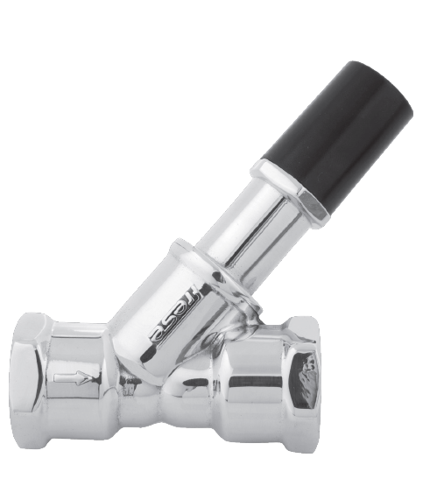
Frese DPRV
Introduction

Slide 3

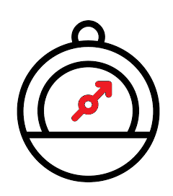


Frese DPRV
Introduction
Noise / pressure
protection
Minimum flow
security
Quick access to desired water temperature

Slide 4
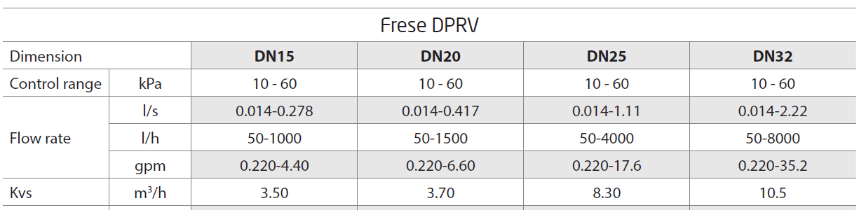
Frese DPRV
Product range
Frese DPRV – differential pressure relief valve in sizes DN15 – DN32
Frese DPRV is an adjustable differential pressure relief valve produced in sizes DN15-DN32, that ensures the differential pressure across circuit is not exceeded, and a minimum flow through the circuit will be maintained when the control valves are closing down.

Slide 5
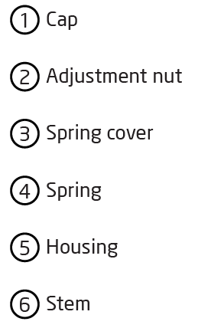
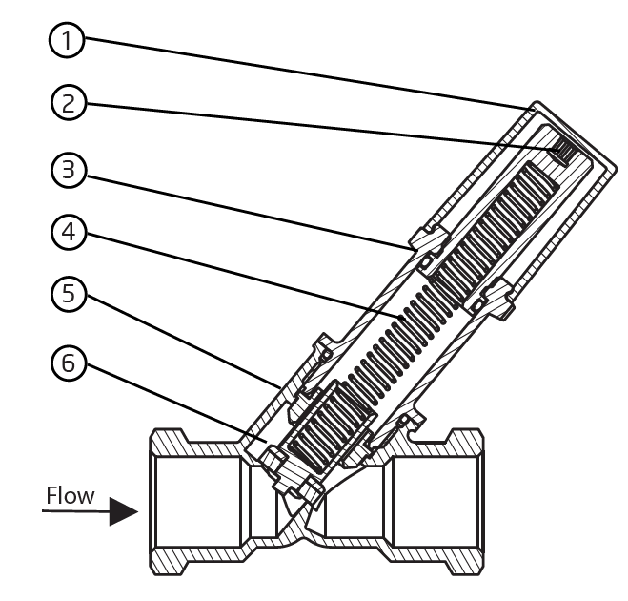
Frese DPRV
Construction
The valve consists of a housing and the differential pressure setting and control unit.
The adjustment nut is used to compress the spring that closes the valve by
pushing the valve cone towards the valve seat.
The more the spring is compressed the harder for the valve it is to open and consequently it opens at higher differential pressure.
The valve opens on rising pressure, when the water pressure exceeds the set value.

Slide 6
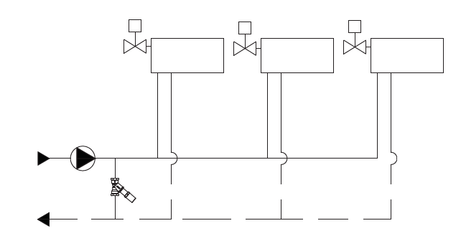
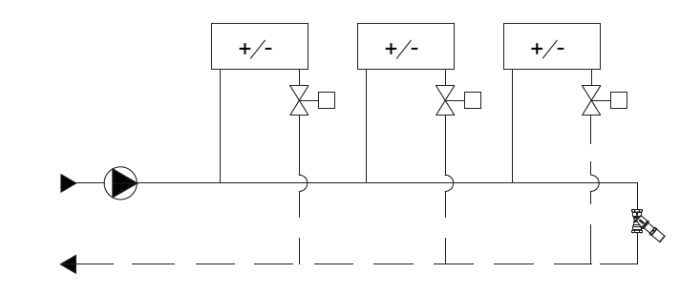
Frese DPRV
Application
Frese DPRV is used as a pump by-pass or end of the branch by-pass.
When Frese DPRV is used as a pump by-pass it protects the system against too high pressure which might propagate in the system as the control valves reduce or close the flow to the terminal units.
Frese DPRV can be also used as a by-pass at the end of a branch to secure the terminal units with constant access to the water of required temperature even when all the control valves in the branch are closed.

Slide 7
Frese DPRV
Application
From chiller
Pressure relief valve
From chiller
By-pass valve
Another application of Frese DPRV may be a cooling system where a chiller
requires certain water flow to prevent it from freezing.
This can be achieved both when the valve is used as a pump-bypass or when installed at the end of the branch.

Slide 8
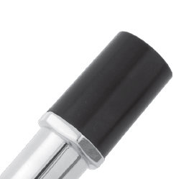
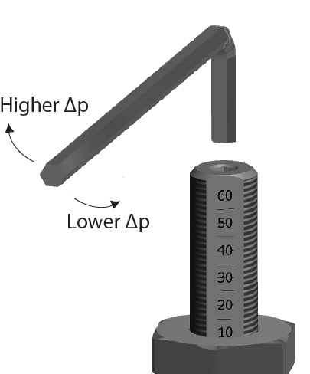
Frese DPRV
Setting
Setting of Frese DPRV is done by removing the cap and using an Allen key.
Before pre-setting the valve, the cap needs to be removed.
The valve is easily set by means of a 4mm hexagonal key.
By use of the scale, the pre-setting of the valve can be easily adjusted.

Slide 9
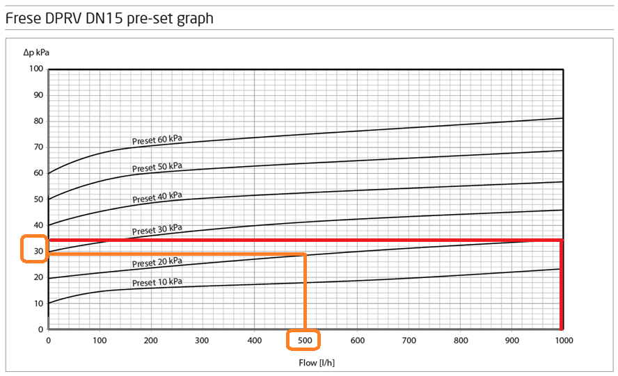
Frese DPRV
Operation
Example:
Maximum allowed pressure difference in the system: 30kPa Approximate flow to be by-passed through Frese DPRV: 500l/h; valve setting should be 20kPa.
In order to properly set the valve to the required differential pressure the graphs in the tech-note should be consulted.
The Frese DPRV will open up and bypass the water, when the differential pressure between the supply and the return line exceeds the pre-set value, and will secure a minimum flow through the circuit. Should the pressure in the system increase further, the flow through the Frese DPRV valve will also increase. In the example above the flow increases from the required 500l/h to 1000l/h and the pressure loss increases over the valve (differential pressure in the system) from 30kPa to around 35kPa at the setting of 20kPa of differential pressure.

Slide 10

Frese DPRV
Benefits
Secures quick access to water of desired temperature after control valves have been closed and start opening.
Prevents too high pressure in the system.
Decreases the risk of noise.

Slide 11

Frese DPRV
Contact
Thank you ☺

